Slide 1
Microsoft Teams User Group Berlin
9. Juni 2022
Meetup #19

Slide 2
Danke!

Slide 3
Agenda
18:00 - 18:15 | Landing Zone
18:15 - 19:15 | Talk 1 – Microsoft Teams SIP Gateway Thorsten Pickhan (@tpickhan)
19:15 - 19:45 | Microsoft Teams Neuigkeiten Thomas Stensitzki (@stensitzki)
19:45 - ? | Fragen und Antworten rund um Microsoft Teams Organisatorisches
Dieses Meeting wird aufgezeichnet und online bereitgestellt. This meeting will be recorded and made available online.

Slide 4
Microsoft Teams SIP Gateway
Thorsten Pickhan @tpickhan

Slide 6
Neues in Microsoft Teams Ankündigungen & Rollouts
Updates
Meetup #19 Thomas Stensitzki

Slide 7
Neuigkeiten in Microsoft Teams
Microsoft Teams: Casting from Teams desktop client to Microsoft Teams Rooms
Microsoft Teams: Text Predictions for Teams Mobile (Android) Weitere Informationen
Multi-language Teams meeting invite control
Co-organizer Meeting Role
Multitasking Panel for Meetings on iPad
Upcoming feature release: Teams Button long press to Raise Hand during meeting

Slide 8
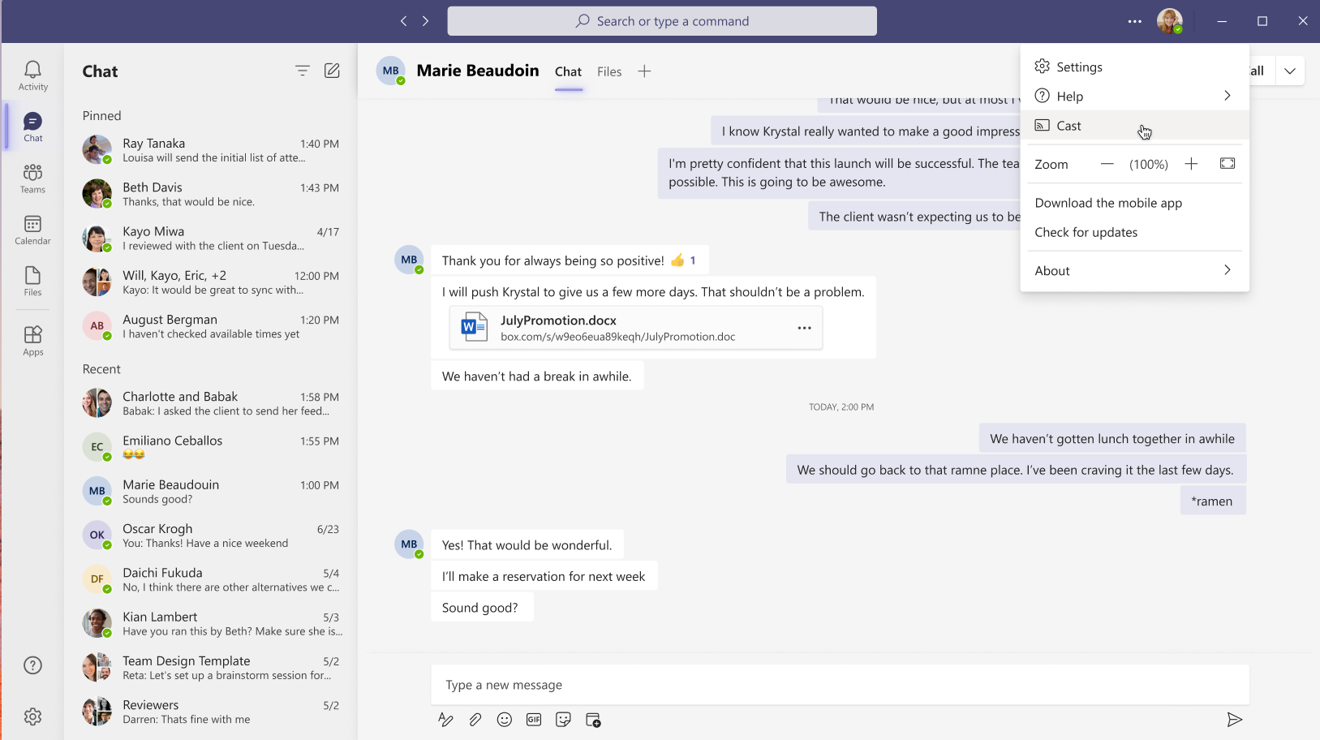
Microsoft Teams: Casting from Teams desktop client to Microsoft Teams Rooms

Slide 9
Neuigkeiten in Microsoft Teams
Microsoft Teams: Casting from Teams desktop client to Microsoft Teams Rooms
Microsoft Teams: Text Predictions for Teams Mobile (Android) Weitere Informationen
Multi-language Teams meeting invite control
Co-organizer Meeting Role
Multitasking Panel for Meetings on iPad
Upcoming feature release: Teams Button long press to Raise Hand during meeting

Slide 10
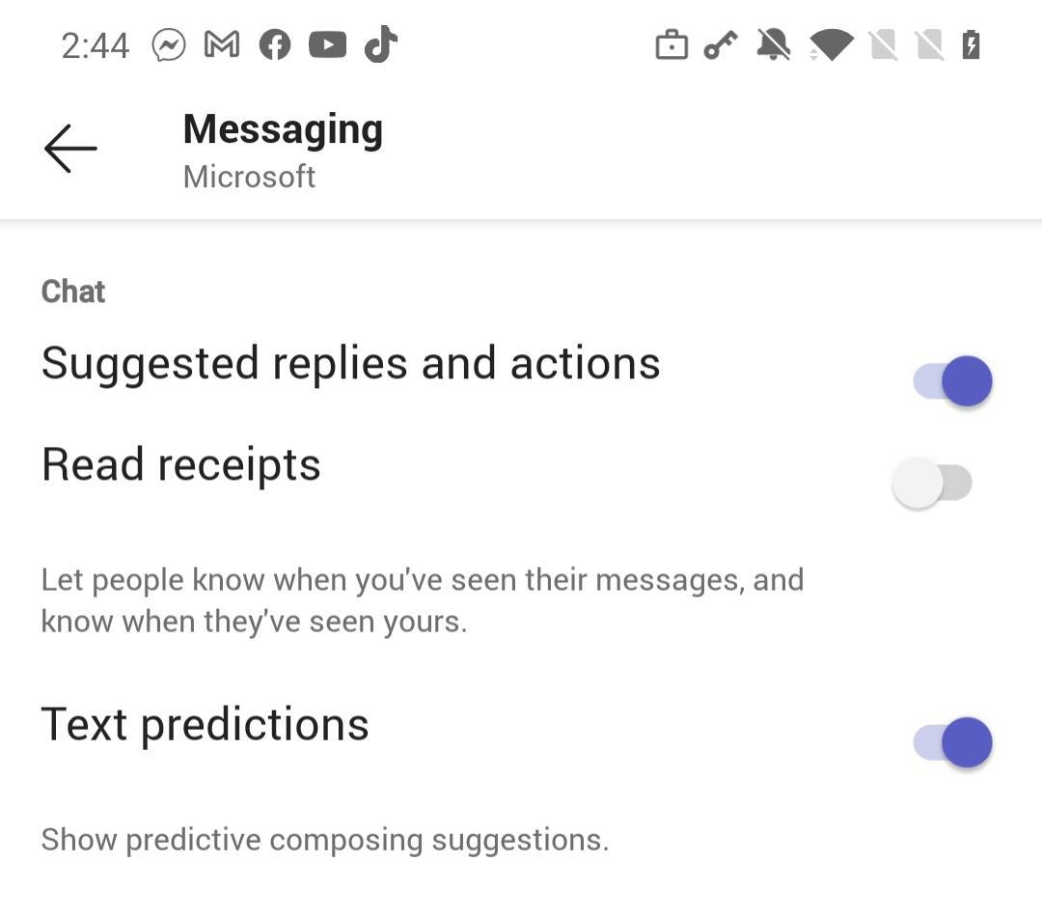
Microsoft Teams: Text Predictions for Teams Mobile (Android)
Notes:
https://docs.microsoft.com/microsoftteams/messaging-policies-in-teams?WT.mc_id=TM-MVP-5003086

Slide 11
Neuigkeiten in Microsoft Teams
Microsoft Teams: Casting from Teams desktop client to Microsoft Teams Rooms
Microsoft Teams: Text Predictions for Teams Mobile (Android) Weitere Informationen
Multi-language Teams meeting invite control
Co-organizer Meeting Role
Multitasking Panel for Meetings on iPad
Upcoming feature release: Teams Button long press to Raise Hand during meeting

Slide 12
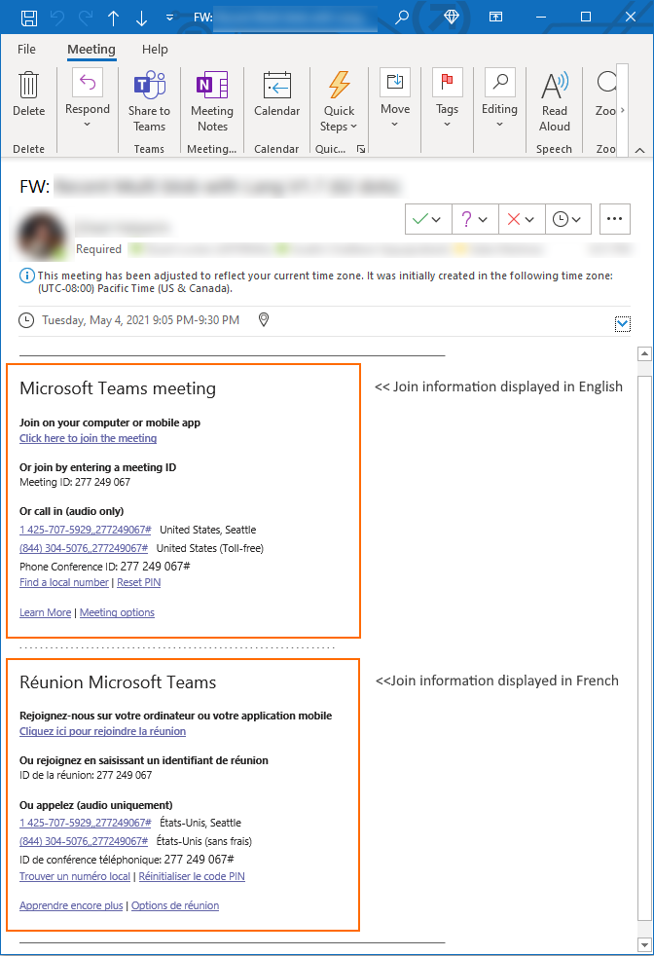
Multi-language Teams meeting invite control
Set-CsTeamsMeetingPolicy -Identity Global -MeetingInviteLanguages "en-US"
To set multiple languages
In the above example, the administrator is setting the meeting invite language to English (en-US) and French (fr-FR).
Set-CsTeamsMeetingPolicy -Identity Global -MeetingInviteLanguages "en-US,fr-FR"
Notes:
The order of the languages displayed in the meeting invite follows the order of the languages specified in the PowerShell cmdlet.
If -MeetingInviteLanguages was not set on the policy (default), there will be no impact to the user and the preferred user language will take effect.
Notes:
https://docs.microsoft.com/powershell/module/skype/set-csteamsmeetingpolicy?view=skype-ps&WT.mc_id=TM-MVP-5003086

Slide 13
Neuigkeiten in Microsoft Teams
Microsoft Teams: Casting from Teams desktop client to Microsoft Teams Rooms
Microsoft Teams: Text Predictions for Teams Mobile (Android) Weitere Informationen
Multi-language Teams meeting invite control
Co-organizer Meeting Role
Multitasking Panel for Meetings on iPad
Upcoming feature release: Teams Button long press to Raise Hand during meeting

Slide 14
Co-organizer Meeting Role
Co-organizers can
Access and change meeting options
Bypass the lobby
Admit people from the lobby during a meeting
Lock the meeting
Present content
Change another participant’s meeting role
End the meeting for all
Co-organizers cannot
Create & manage breakout rooms
View & download attendance reports
Manage the meeting recording
Edit the meeting invitation
Remove or change the Organizer role

Slide 15
Neuigkeiten in Microsoft Teams
Microsoft Teams: Casting from Teams desktop client to Microsoft Teams Rooms
Microsoft Teams: Text Predictions for Teams Mobile (Android) Weitere Informationen
Multi-language Teams meeting invite control
Co-organizer Meeting Role
Multitasking Panel for Meetings on iPad
Upcoming feature release: Teams Button long press to Raise Hand during meeting

Slide 16
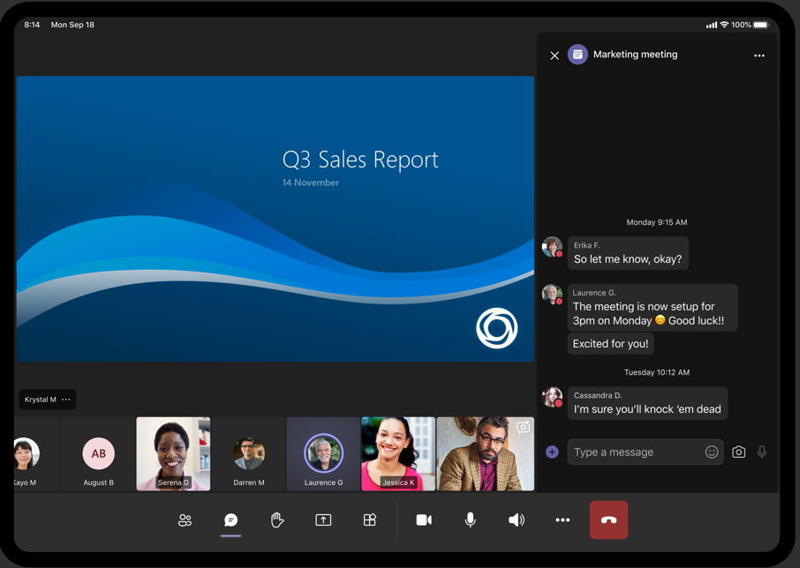
Multitasking Panel for Meetings on iPad

Slide 17
Neuigkeiten in Microsoft Teams
Microsoft Teams: Casting from Teams desktop client to Microsoft Teams Rooms
Microsoft Teams: Text Predictions for Teams Mobile (Android) Weitere Informationen
Multi-language Teams meeting invite control
Co-organizer Meeting Role
Multitasking Panel for Meetings on iPad
Upcoming feature release: Teams Button long press to Raise Hand during meeting

Slide 18
Neuigkeiten in Microsoft Teams
Dynamic Caller ID in Calls app for Call Queue Agents
Meeting Chat Bubbles on Android
Join Meetings by a Meeting ID and Passcode
Microsoft Teams: Casting from Teams desktop client to Microsoft Teams Rooms
Call control with bluetooth headsets and speakerphones
Teams Meeting Poll New Question Type – Rating
Meeting Chat Bubbles on iOS

Slide 19
Dynamic Caller ID in Calls app for Call Queue Agents
The resource account used for calling ID purposes must have a Microsoft Teams Phone System Virtual User license and one of the following assigned:
A Calling Plan license and a phone number assigned
An Operator Connect phone number assigned
An online voice routing policy (phone number assignment is optional when using Direct Routing)
Notes:
https://docs.microsoft.com/microsoftteams/create-a-phone-system-call-queue?WT.mc_id=TM-MVP-5003086

Slide 20
Neuigkeiten in Microsoft Teams
Dynamic Caller ID in Calls app for Call Queue Agents
Meeting Chat Bubbles on Android
Join Meetings by a Meeting ID and Passcode
Microsoft Teams: Casting from Teams desktop client to Microsoft Teams Rooms
Call control with bluetooth headsets and speakerphones
Teams Meeting Poll New Question Type – Rating
Meeting Chat Bubbles on iOS

Slide 21
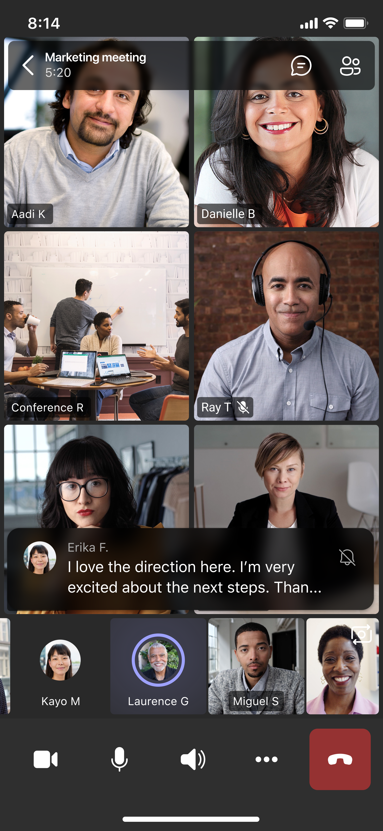
Meeting Chat Bubbles on Android

Slide 22
Neuigkeiten in Microsoft Teams
Dynamic Caller ID in Calls app for Call Queue Agents
Meeting Chat Bubbles on Android
Join Meetings by a Meeting ID and Passcode
Microsoft Teams: Casting from Teams desktop client to Microsoft Teams Rooms
Call control with bluetooth headsets and speakerphones
Teams Meeting Poll New Question Type – Rating
Meeting Chat Bubbles on iOS

Slide 23
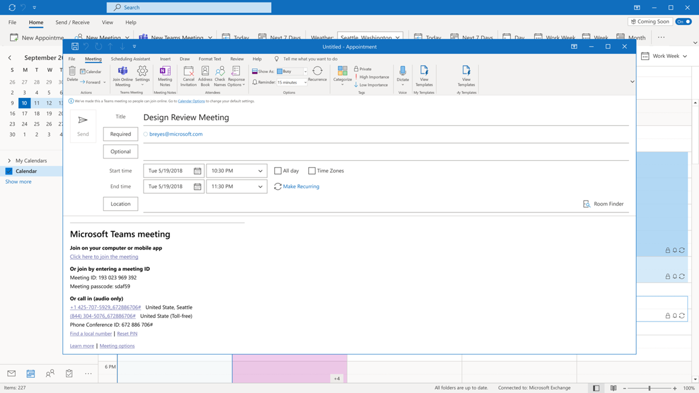
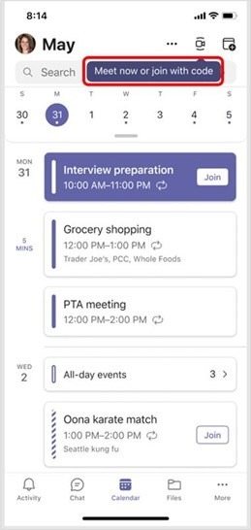
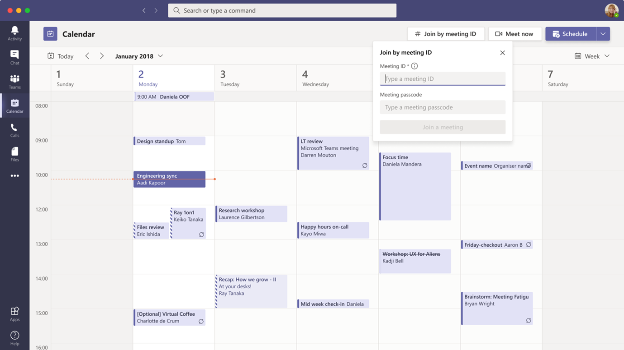
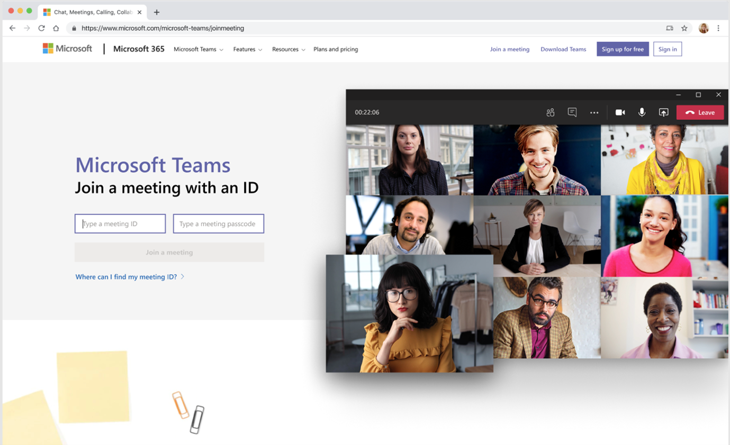
Join Meetings by a Meeting ID and Passcode

Slide 24
Neuigkeiten in Microsoft Teams
Dynamic Caller ID in Calls app for Call Queue Agents
Meeting Chat Bubbles on Android
Join Meetings by a Meeting ID and Passcode
Microsoft Teams: Casting from Teams desktop client to Microsoft Teams Rooms
Call control with bluetooth headsets and speakerphones
Teams Meeting Poll New Question Type – Rating
Meeting Chat Bubbles on iOS

Slide 25
Microsoft Teams: Casting from Teams desktop client to Microsoft Teams Rooms

Slide 26
Neuigkeiten in Microsoft Teams
Dynamic Caller ID in Calls app for Call Queue Agents
Meeting Chat Bubbles on Android
Join Meetings by a Meeting ID and Passcode
Microsoft Teams: Casting from Teams desktop client to Microsoft Teams Rooms
Call control with bluetooth headsets and speakerphones
Teams Meeting Poll New Question Type – Rating
Meeting Chat Bubbles on iOS

Slide 27
Neuigkeiten in Microsoft Teams
Dynamic Caller ID in Calls app for Call Queue Agents
Meeting Chat Bubbles on Android
Join Meetings by a Meeting ID and Passcode
Microsoft Teams: Casting from Teams desktop client to Microsoft Teams Rooms
Call control with bluetooth headsets and speakerphones
Teams Meeting Poll New Question Type – Rating
Meeting Chat Bubbles on iOS

Slide 28
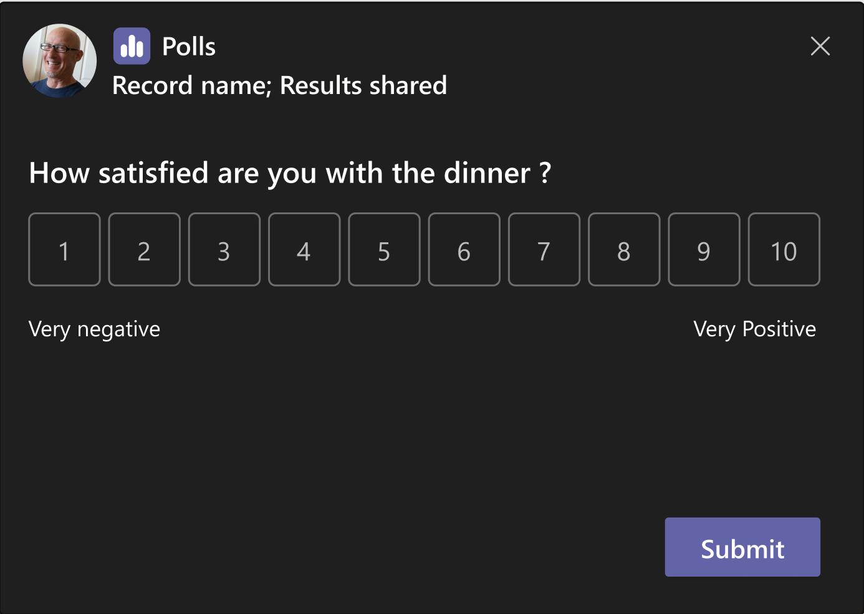
Teams Meeting Poll New Question Type - Rating

Slide 29
Neuigkeiten in Microsoft Teams
Dynamic Caller ID in Calls app for Call Queue Agents
Meeting Chat Bubbles on Android
Join Meetings by a Meeting ID and Passcode
Microsoft Teams: Casting from Teams desktop client to Microsoft Teams Rooms
Call control with bluetooth headsets and speakerphones
Teams Meeting Poll New Question Type – Rating
Meeting Chat Bubbles on iOS

Slide 30

Meeting Chat Bubbles on iOS

Slide 31
Neuigkeiten in Microsoft Teams
Teams Meeting Recordings Auto-Expiration in OneDrive and SharePoint Weitere Informationen
Collaborative Annotations on Presenter Shared Screen Weitere Informationen
Soft focus and Adjust brightness in Teams video meetings
Suggested Replies in Teams Desktop Weitere Informationen
Frictionless app re-install for users
Exchange Contacts Available in Calling Pickers in Teams Roadmap ID

Slide 32
Neuigkeiten in Microsoft Teams
Teams Meeting Recordings Auto-Expiration in OneDrive and SharePoint Weitere Informationen
Collaborative Annotations on Presenter Shared Screen Weitere Informationen
Soft focus and Adjust brightness in Teams video meetings
Suggested Replies in Teams Desktop Weitere Informationen
Frictionless app re-install for users
Exchange Contacts Available in Calling Pickers in Teams Roadmap ID

Slide 33
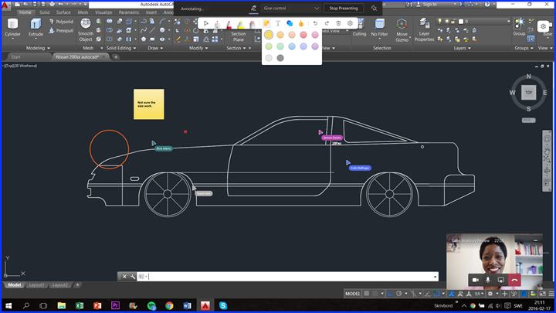
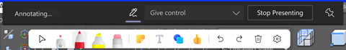
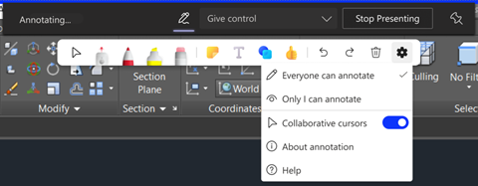
Collaborative Annotations on Presenter Shared Screen

Slide 34
Neuigkeiten in Microsoft Teams
Teams Meeting Recordings Auto-Expiration in OneDrive and SharePoint Weitere Informationen
Collaborative Annotations on Presenter Shared Screen Weitere Informationen
Soft focus and Adjust brightness in Teams video meetings
Suggested Replies in Teams Desktop Weitere Informationen
Frictionless app re-install for users
Exchange Contacts Available in Calling Pickers in Teams Roadmap ID

Slide 35
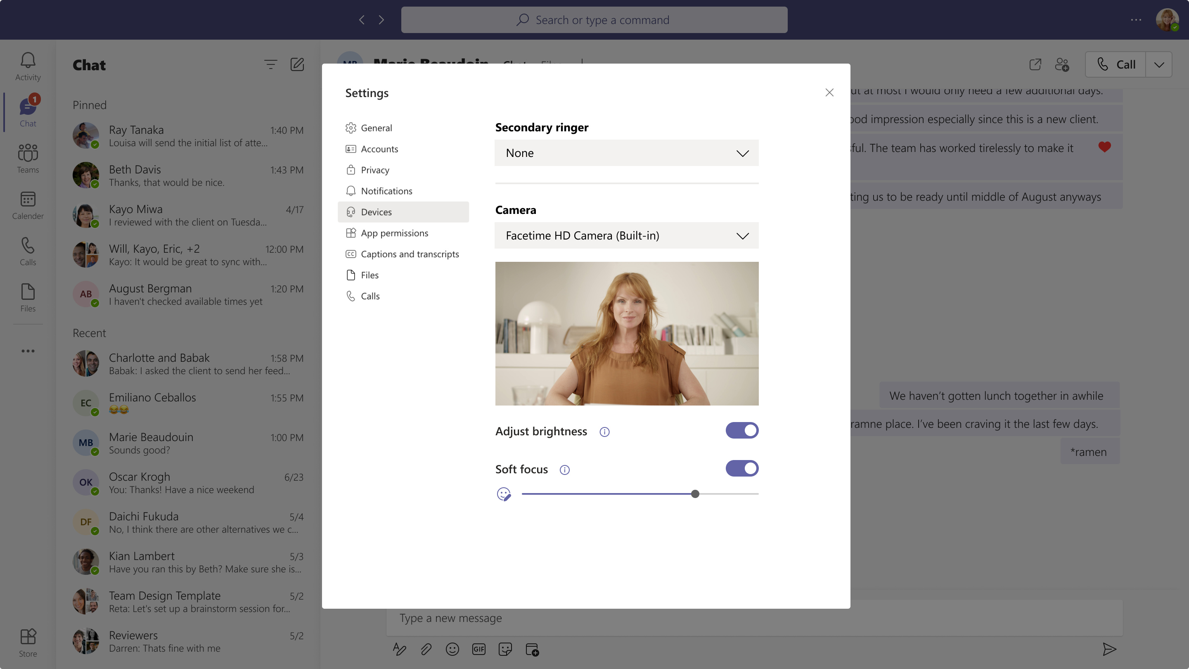
Soft focus and Adjust brightness in Teams video meetings

Slide 36
Neuigkeiten in Microsoft Teams
Teams Meeting Recordings Auto-Expiration in OneDrive and SharePoint Weitere Informationen
Collaborative Annotations on Presenter Shared Screen Weitere Informationen
Soft focus and Adjust brightness in Teams video meetings
Suggested Replies in Teams Desktop Weitere Informationen
Frictionless app re-install for users
Exchange Contacts Available in Calling Pickers in Teams Roadmap ID

Slide 37
Neuigkeiten in Microsoft Teams
Teams Meeting Recordings Auto-Expiration in OneDrive and SharePoint Weitere Informationen
Collaborative Annotations on Presenter Shared Screen Weitere Informationen
Soft focus and Adjust brightness in Teams video meetings
Suggested Replies in Teams Desktop Weitere Informationen
Frictionless app re-install for users
Exchange Contacts Available in Calling Pickers in Teams Roadmap ID

Slide 38
Neuigkeiten in Microsoft Teams
Teams Meeting Recordings Auto-Expiration in OneDrive and SharePoint Weitere Informationen
Collaborative Annotations on Presenter Shared Screen Weitere Informationen
Soft focus and Adjust brightness in Teams video meetings
Suggested Replies in Teams Desktop Weitere Informationen
Frictionless app re-install for users
Exchange Contacts Available in Calling Pickers in Teams Roadmap ID

Slide 39
Neuigkeiten in Microsoft Teams
View Together Mode for Everyone

Slide 40
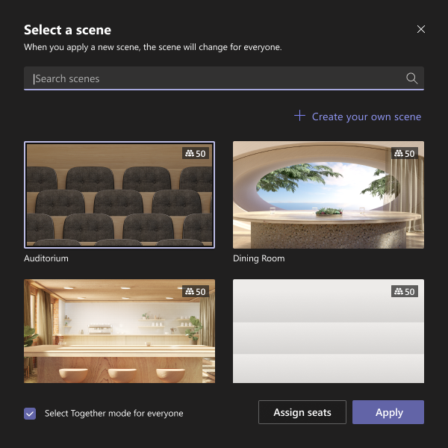
View Together Mode for Everyone

Slide 41
Neuigkeiten in Microsoft Teams für Admins
Teams PowerShell Module – versions older than 4.x.x to be retired → June 15, 2022
User requests for apps in Teams store
Teams user/device usage report and Graph API data source change
Updating default tenant-level tag management settings Weitere Informationen
Improved Meeting Support in Firefox Browser
New Microsoft Teams Panels Update (April 2022 Update) Weitere Information

Slide 42
Neuigkeiten in Microsoft Teams für Admins
Teams PowerShell Module – versions older than 4.x.x to be retired → June 15, 2022
User requests for apps in Teams store
Teams user/device usage report and Graph API data source change
Updating default tenant-level tag management settings Weitere Informationen
Improved Meeting Support in Firefox Browser
New Microsoft Teams Panels Update (April 2022 Update) Weitere Information

Slide 43
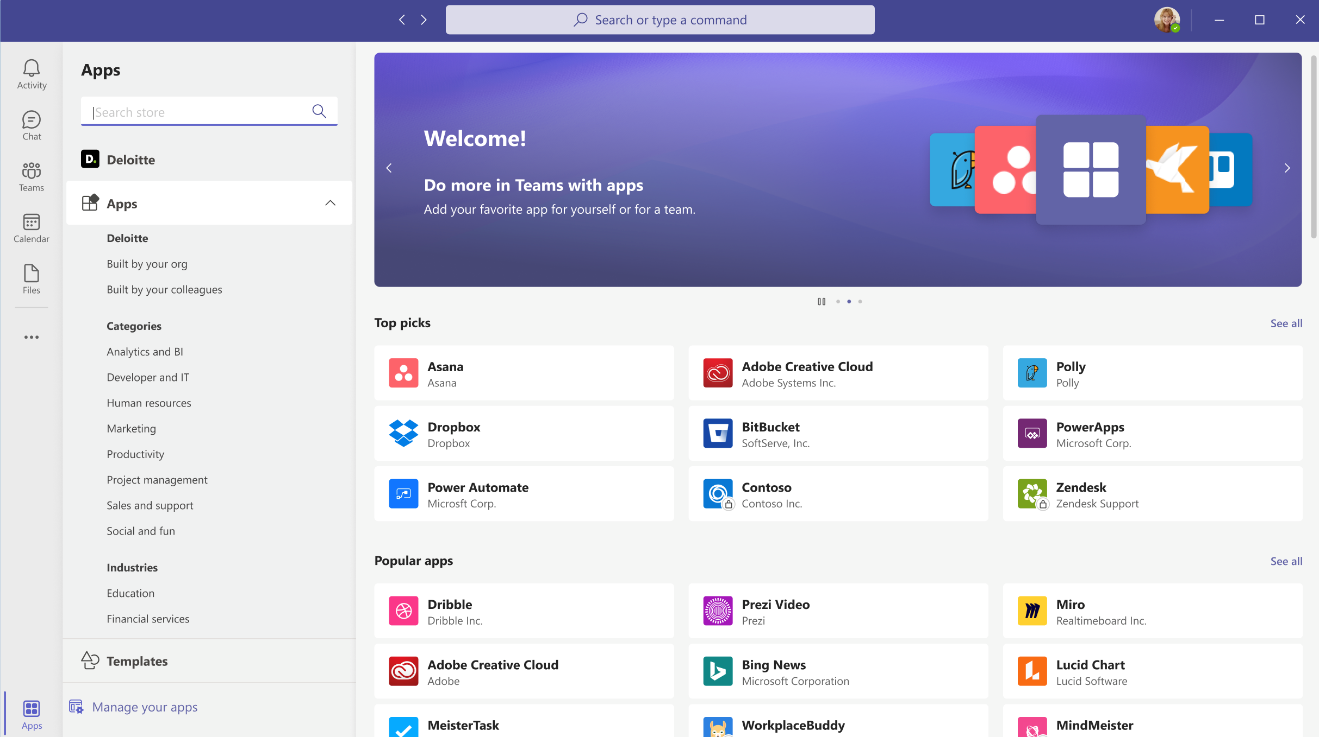
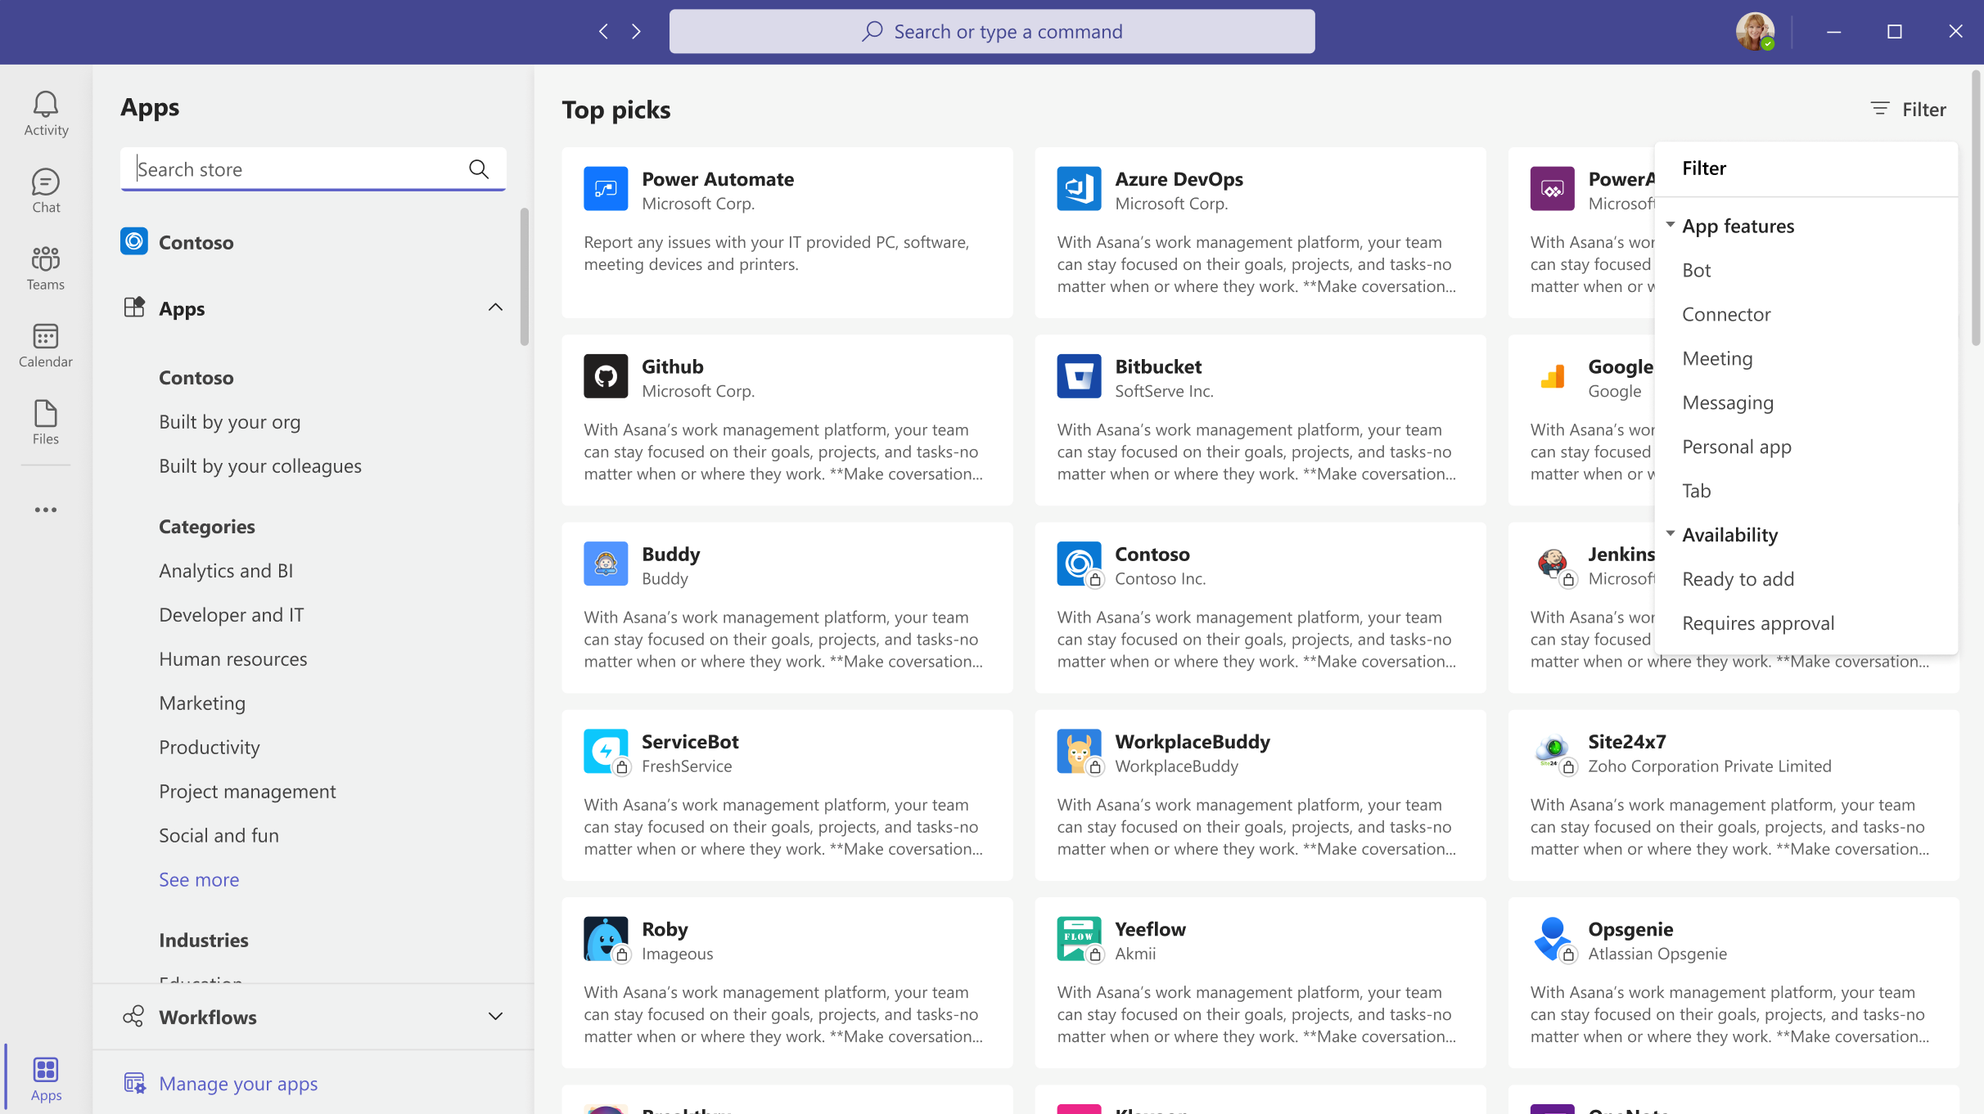
User requests for apps in Teams store

Slide 44
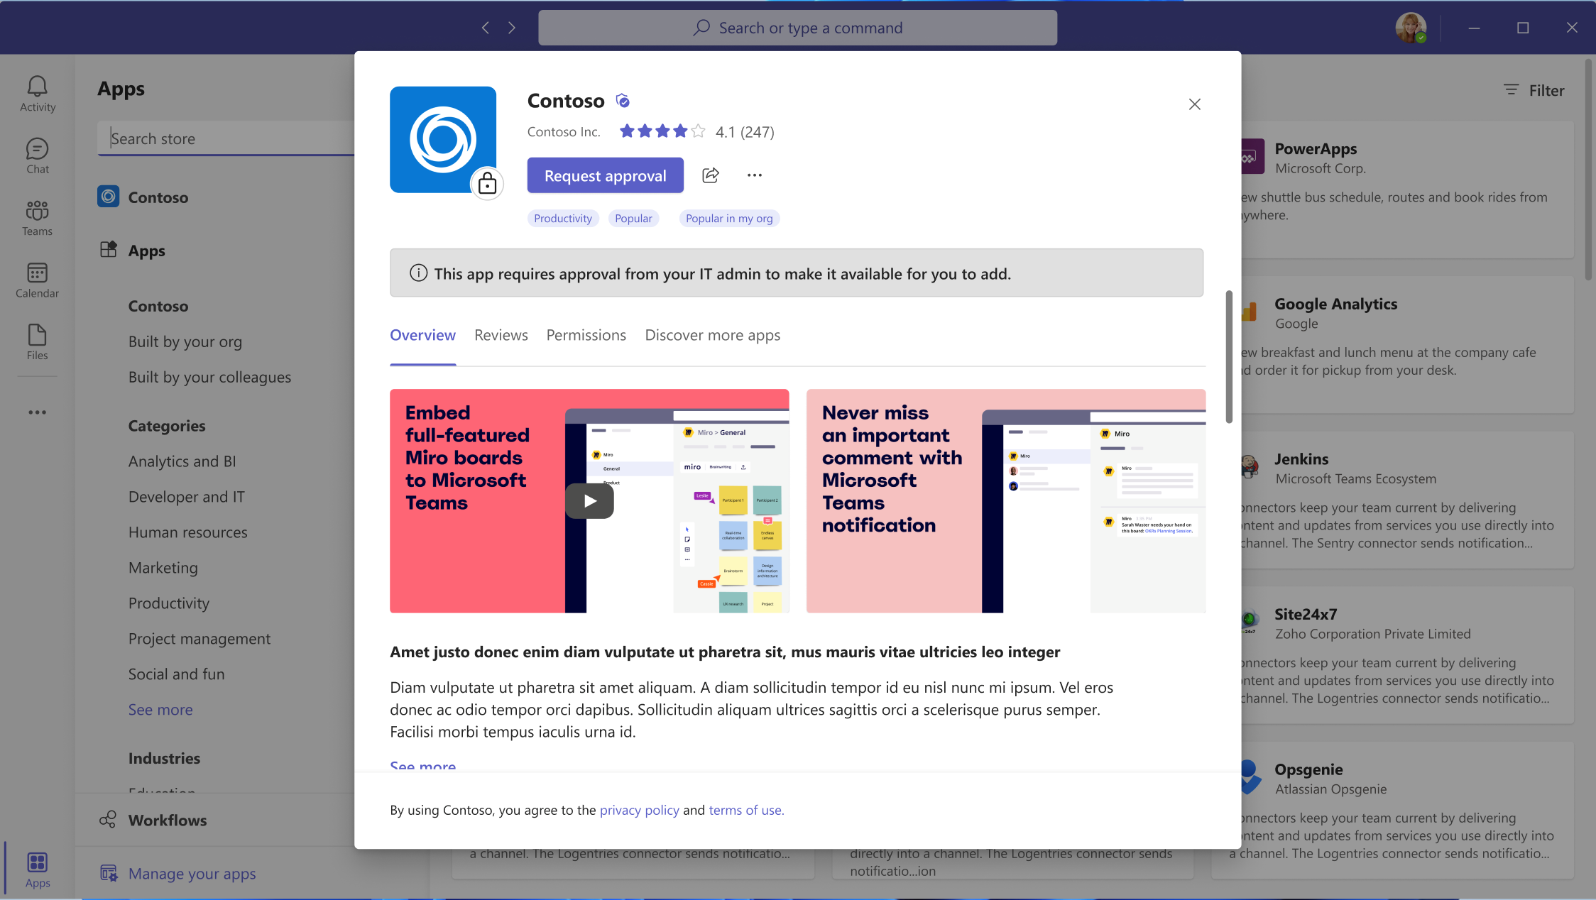
User requests for apps in Teams store User View

Slide 45
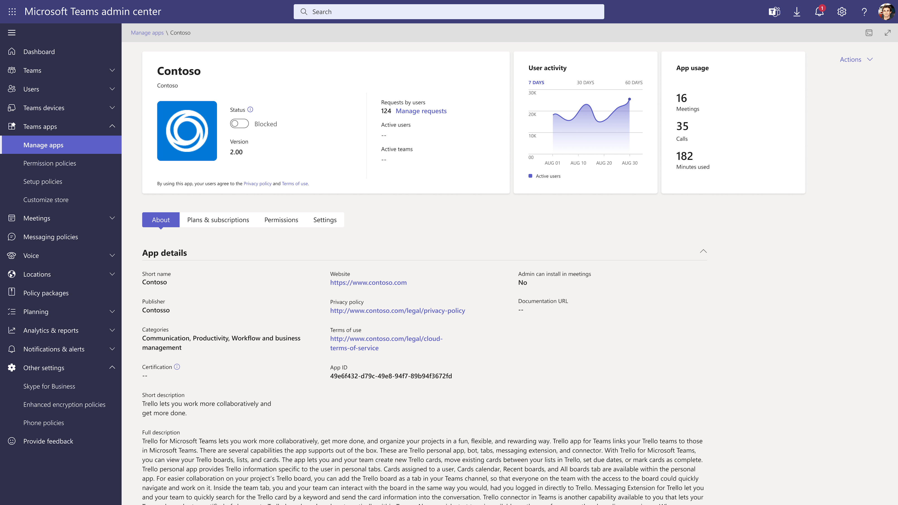
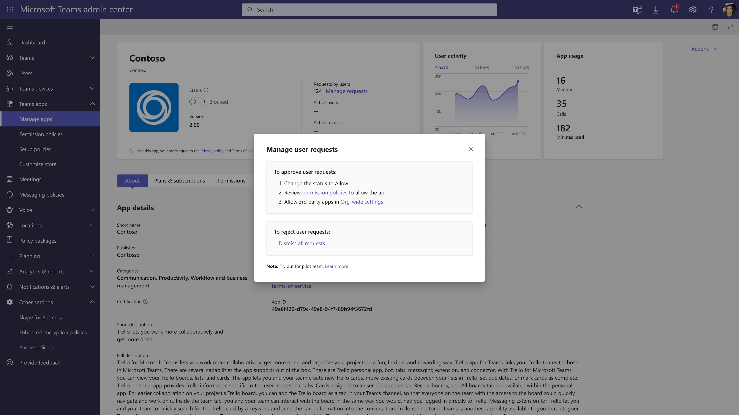
User requests for apps in Teams store Admin View

Slide 46
Neuigkeiten in Microsoft Teams für Admins
Teams PowerShell Module – versions older than 4.x.x to be retired → June 15, 2022
User requests for apps in Teams store
Teams user/device usage report and Graph API data source change
Updating default tenant-level tag management settings Weitere Informationen
Improved Meeting Support in Firefox Browser
New Microsoft Teams Panels Update (April 2022 Update) Weitere Information

Slide 47
Neuigkeiten in Microsoft Teams für Admins
Teams PowerShell Module – versions older than 4.x.x to be retired → June 15, 2022
User requests for apps in Teams store
Teams user/device usage report and Graph API data source change
Updating default tenant-level tag management settings Weitere Informationen
Improved Meeting Support in Firefox Browser
New Microsoft Teams Panels Update (April 2022 Update) Weitere Information

Slide 48
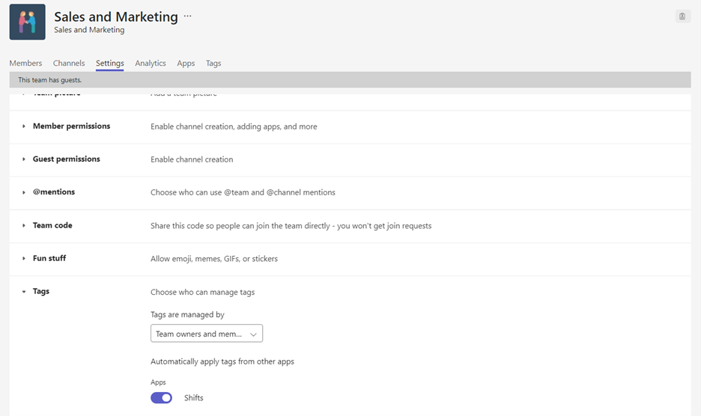
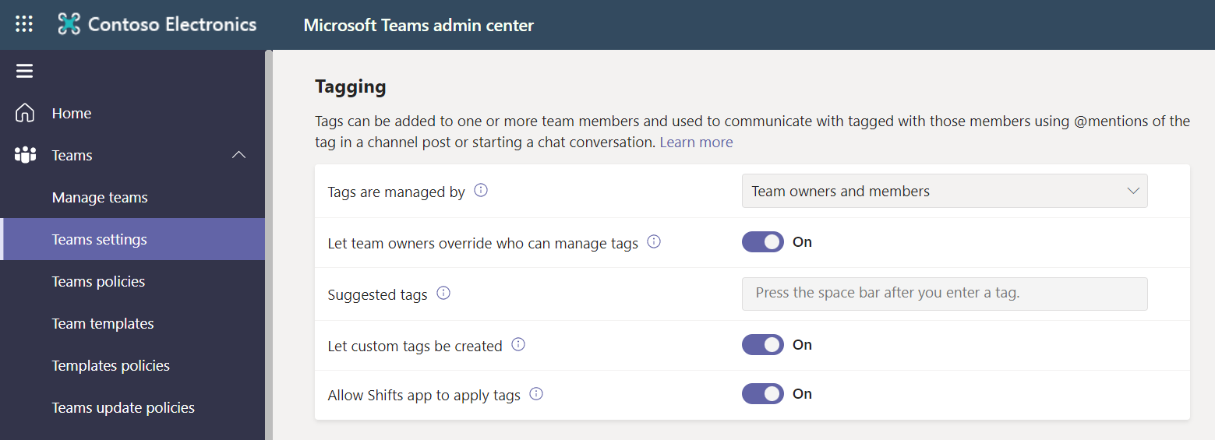
Updating default tenant-level tag management settings

Slide 49
Neuigkeiten in Microsoft Teams für Admins
Teams PowerShell Module – versions older than 4.x.x to be retired → June 15, 2022
User requests for apps in Teams store
Teams user/device usage report and Graph API data source change
Updating default tenant-level tag management settings Weitere Informationen
Improved Meeting Support in Firefox Browser
New Microsoft Teams Panels Update (April 2022 Update) Weitere Information

Slide 50
Neuigkeiten in Microsoft Teams für Admins
Teams PowerShell Module – versions older than 4.x.x to be retired → June 15, 2022
User requests for apps in Teams store
Teams user/device usage report and Graph API data source change
Updating default tenant-level tag management settings Weitere Informationen
Improved Meeting Support in Firefox Browser
New Microsoft Teams Panels Update (April 2022 Update) Weitere Information

Slide 51
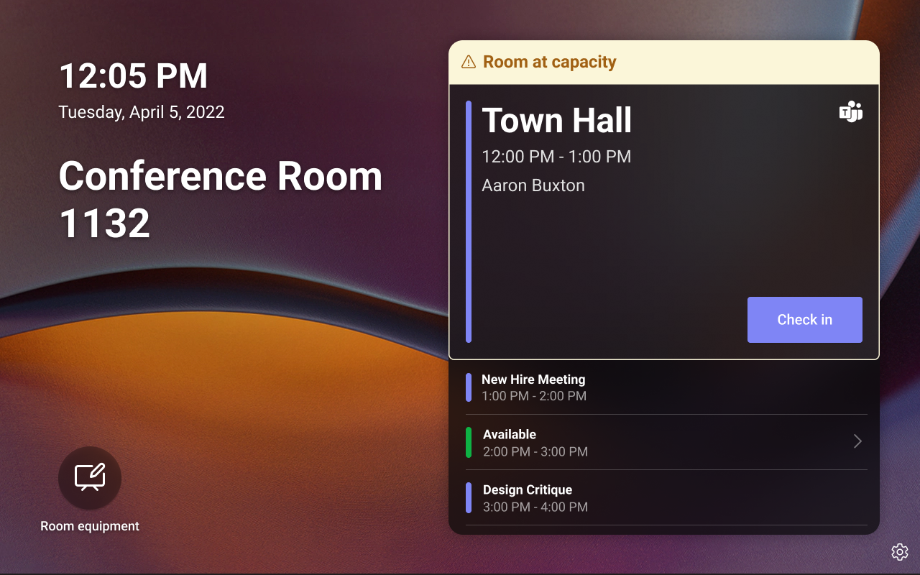
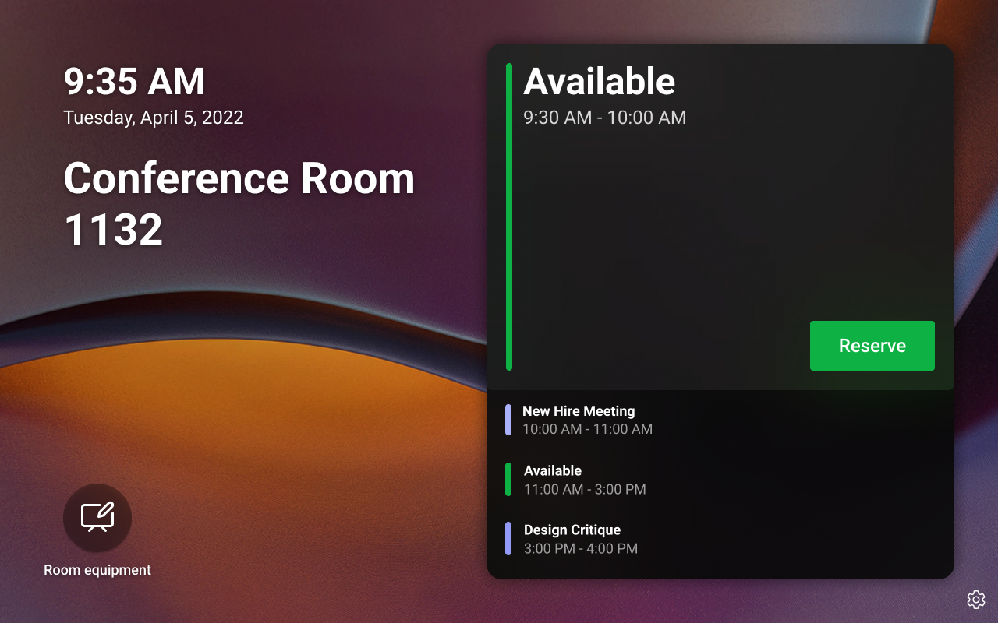
New Microsoft Teams Panels Update (April 2022 Update)

Slide 52
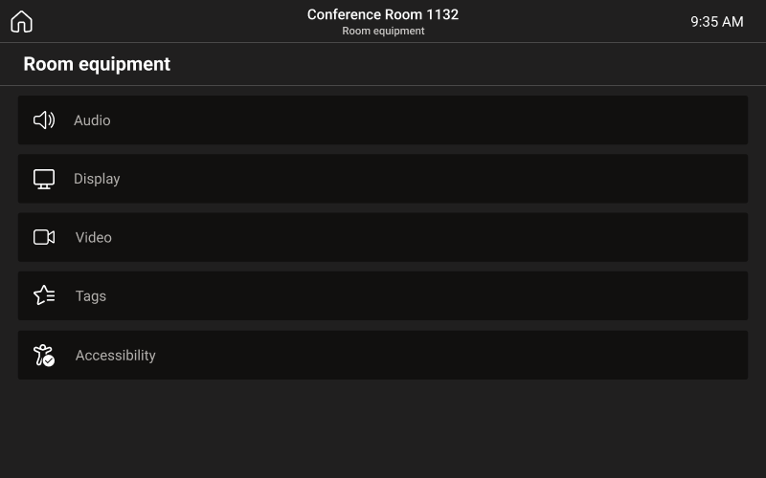
New Microsoft Teams Panels Update (April 2022 Update)

Slide 53
Was ist neu in Teams – Der Blog
What’s New in Microsoft Teams - May 2022
What’s New in Microsoft Teams - April 2022
Microsoft Teams Blog
Microsoft Teams Community Blog
Microsoft Teams Feedback Portal

Slide 54
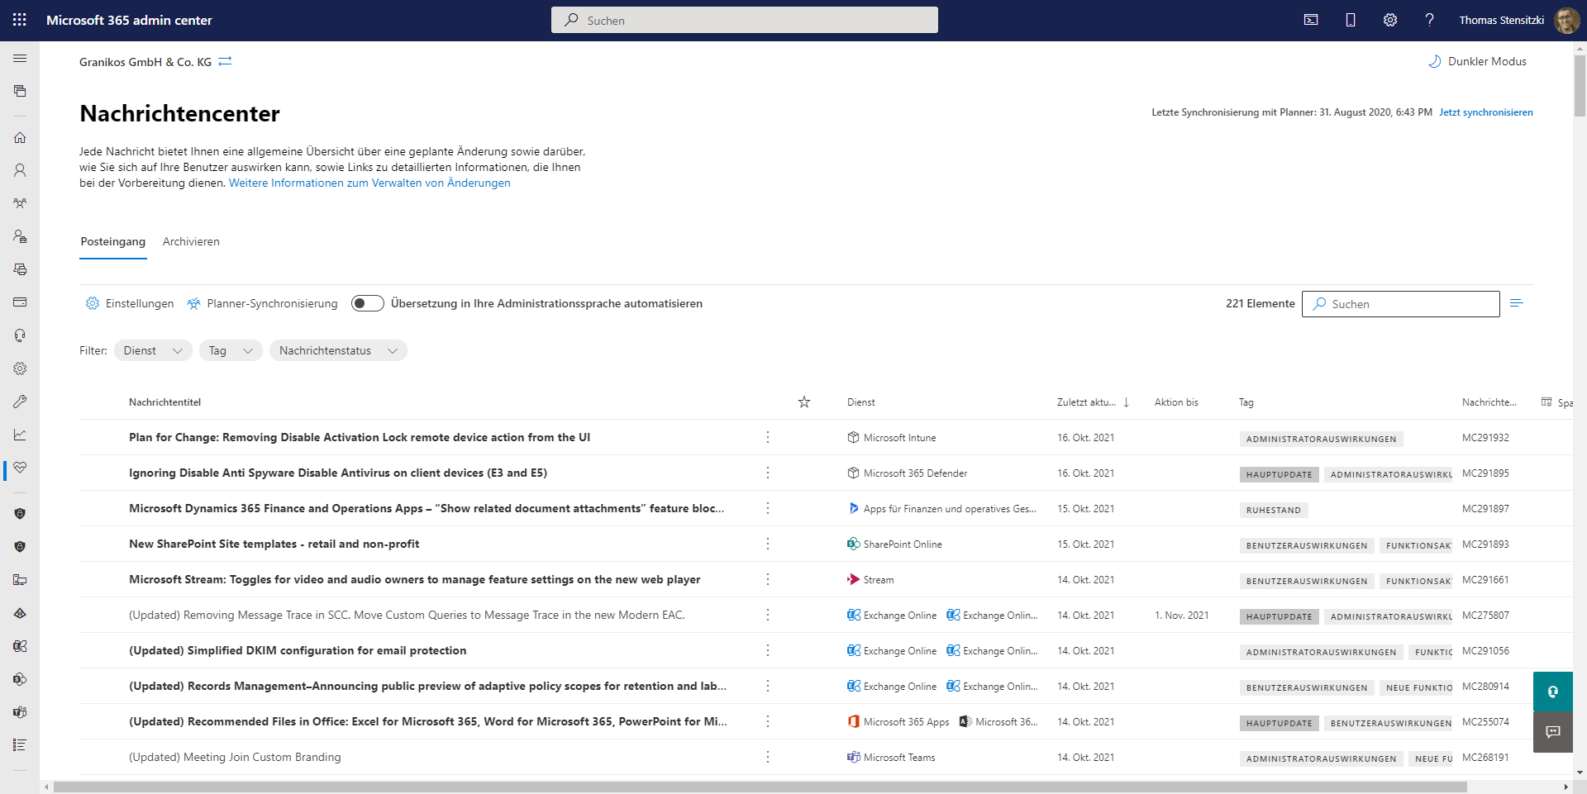
https://admin.microsoft.com/#/MessageCenter

Slide 55
Titel
Speaker @TW

Slide 56
Organisatorisches

Slide 57
Veranstaltungen
Datum
10./11. Juni 2022 | Scottish Summit 2022
29./30. Juni | Commsverse Hybrid Work Conference
11. August 2022 | Teams User Group Meetup #20
20./21. September 2022 | The Experts Conference (TEC)
23. September 2022 | Cloud8 Summit
26.-28. September 2022 | European Cloud Summit

Slide 58
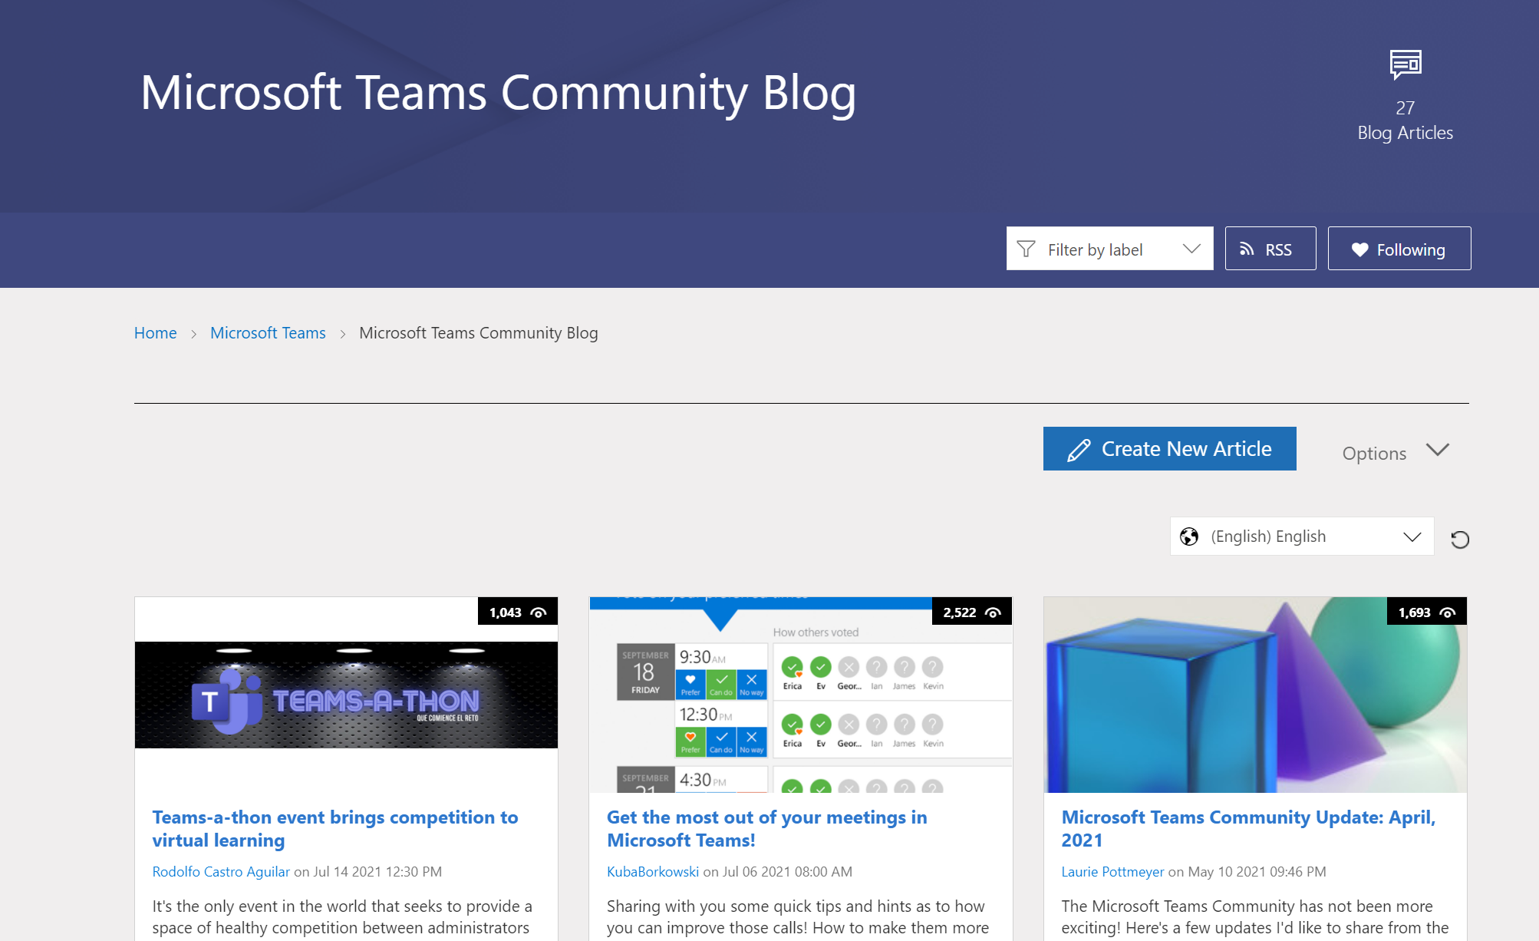
Teams Community Blog
→https://aka.ms/TeamsCommunityBlogger

Slide 59
Organisatorisches
Microsoft Community Tenant für User Groups
Teilnahme als Microsoft 365 Gast
Anmeldung: https://go.granikos.eu/TeamsUGForm
Teams Meeting Teilnahme-Link
https://teamsusergroup.berlin/meetup

Slide 60
Vielen Dank für eure Teilnahme!
Das nächste Meetup:
→ 11. August 2022
https://TeamsUserGroup.Berlin/register
Spread the Word!
#TeamsUGBerlin
Aufzeichnungen unserer Meetups sind im Community Team und bei YouTube verfügbar.

Slide 61
Offene Diskussion

